Slide 1

Place Your Topic Here
Subtitle Here
Free software for Korg© workstations and synthesizers
Michel Keijzers, MiKeSoft
March 6, 2014

Slide 2
Content
Introduction
What is PCG Tools?
What is not in PCG Tools?
Advantages/Disadvantages
Workflow
Platforms
Supported synthesizer models
Supported languages
What is (in) a PCG file?
PCG Windows
Selecting items
Edit
Master Files
Copy & Paste inside a file
Copy & Paste programs between files
Copy & Paste combis between files
Copy & Paste set list slots between files
Copy & Paste settings
Copy & Paste Recall
Clear
Compact
Sort
Timbre Window
Set List Generator
Patch List
Program Usage List
Differences List
Combi Usage List
File Content List
Other goodies
Sequencer files
Song files
Future ideas
Questions

Slide 3
Introduction What is PCG Tools?
Librarian
Very limited editing features
List generator

Slide 4
Introduction What is not (in)PCG Tools?
Editing of sound parameters
(Realtime) MIDI connection to synthesizer
Handling of Sampling files (.KSC, .KSF, .WAV, .AIFF)
Handling of Song/sequencer files (.MID)
VST features

Slide 5
Introduction Advantages/Disadvantages
Compared to Korg Editor
Advantages
Real instrument not needed nearby
Can load multiple Patch Files (e.g. PCG files)
Even from different synthesizer models
Copy/Paste between Patch files
Disadvantages
No MIDI connection
No direct audition of changes
Editor features would not be useful
No Apple version (without Windows emulator)

Slide 6
Introduction Workflow
On Synthesizer: Save Patch (PCG) file by synth to Media*
On computer: Start PCG Tools
On computer: Load saved file (make a backup if needed)
On computer: Optionally, load more Patch files
On computer: Manage file(s)
On computer: Save Patch file on media*
On synthesizer: load Patch file
*e.g. USB Stick, SD Card, CF card, sysex file (depending on synthesizer model)

Slide 7
Introduction Platforms
Windows only
Windows XP with Service Pack 3
Windows Vista
Windows 7
Windows 8
Apple / Linux
Only with Windows emulator

Slide 8
Introduction Supported synthesizer models
Most models use PCG files, but some use dedicated or MIDI System Exclusive (sysex) files:
Korg Kronos, Kronos X
Oasys
Krome
Kross
M3
M50
Triton Extreme, Studio, Classic, LE, Rack, TR
Karma
Trinity V1, V2, V3, TR Rack
microSTATION (soon)
microKorg, microKorg XL, microKorg XL Plus (soon)
MS2000 (soon)

Slide 9
Introduction Supported languages
The following languages are supported (Thanks to a several translators):
Czech
Dutch
English
French
German
Greek (soon)
Portuguese (Brazil)
Portuguese (Portugal)
Serbian (Latin)
Spanish

Slide 10
Introduction What is (in) a PCG file?
A PCG file CAN contain:
Program (bank)s
Combi (bank)s
Set list (slot(s)
Wave sequence (bank)s
Drum kit (bank)s
Global information (e.g. categories)

Slide 11
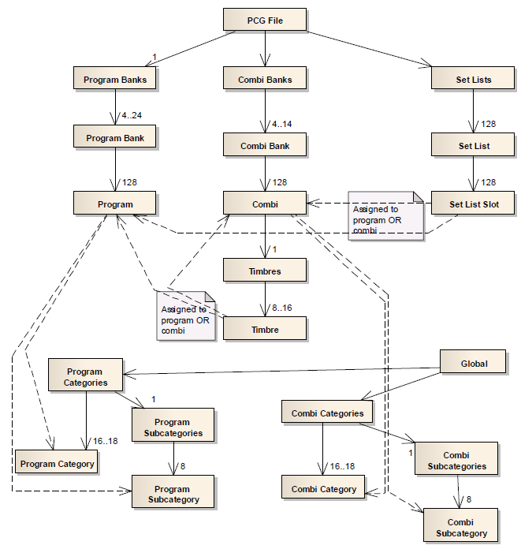
Introduction / What is (in) a PCG file?

Slide 12
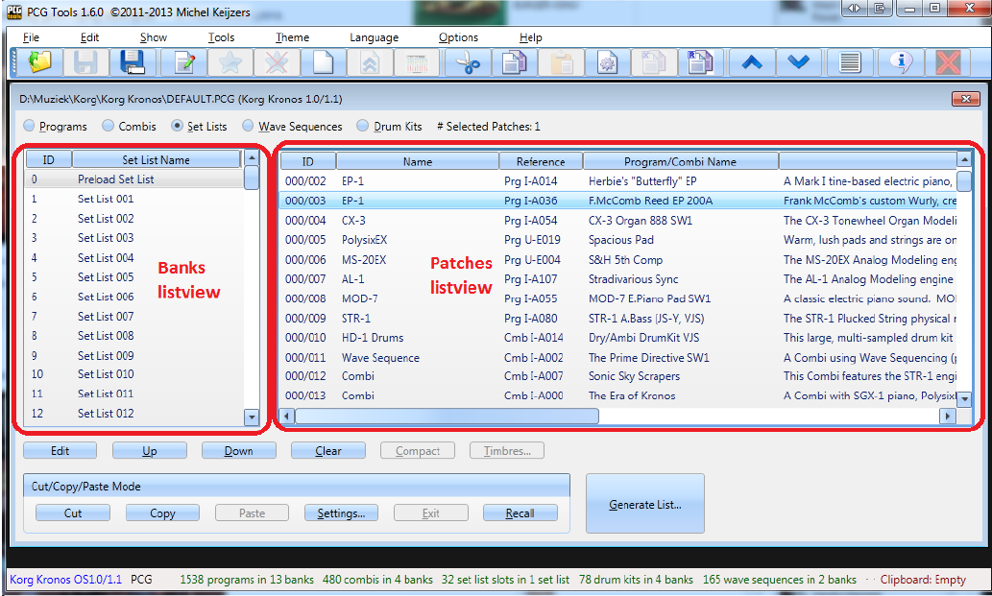
PCG Window Selecting Items
Buttons are functioning different whether 1, more banks or 1 or more patches are selected.

Slide 13
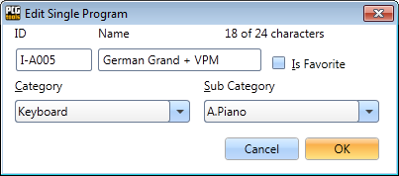
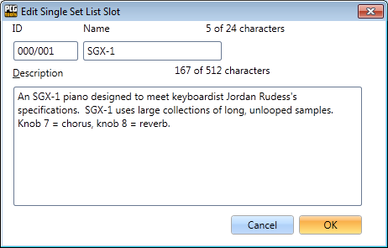
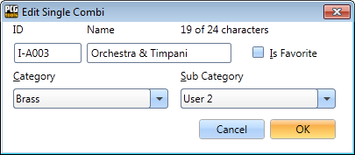
PCG Window Edit
Edit Program, Combi and Set List Slit work similar (but have different screens).
Tip: Double click works too

Slide 14
PCG Window Master Files
Global section contains:
Categories
Sub categories
Consequences if no categories are available:
PCG window show (sub) category numbers instead of names
Sorting on categories will be based on numbers instead of names
Make sure your Master File contains the ‘default’ categories (you use)
A master file can be set per workstation model and optionally be loaded (see Settings)

Slide 15
PCG Window Copy & Paste inside a file
Select 1 or more banks or 1 or more patches
Press the Copy button (or menu, toolbar or Ctrl-C)
Go to the target location
Select 1 or more (empty) patches
Press the Save button (or menu, toolbar, or Ctrl-V)
The results may depend on the Copy/Paste settings

